Slide 1


Slide 2

Objective
What is supervised learning?
Why & What of regression
What is linear regression?
A dose of Mathematics
Mean
Variance
Standard deviation
Gradient Descent
Example
Hypothesis
Confidence Interval
Distribution
t & P values
Multi-variable linear regression
Assignment
Notes:
In London

Slide 3
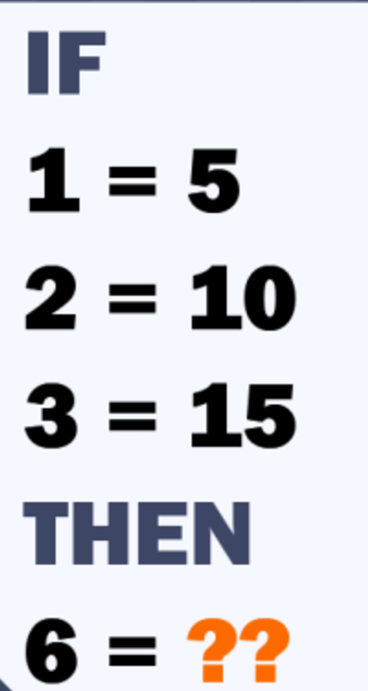
Only For Genius Quiz
Notes:
In London

Slide 4
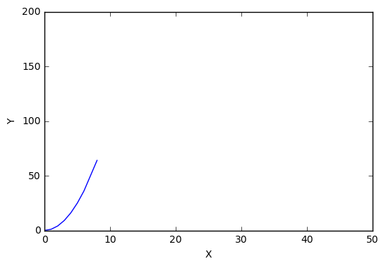
Supervised Learning - Regression
Learn from existing data
Helps in establishing association or independence hypothesis
Helps in predicting future values based on past occurrences
Y = [0, 1, 4, 9, 16, 25, 36, 64]
X = [0, 1, 2, 3, 4, 5, 6, 8]
Notes:
In London

Slide 5
Supervised Learning - Regression
Regression analysis is a statistical process for estimating the relationships among variables. It includes many techniques for modeling and analyzing several variables, when the focus is on the relationship between a dependent variable and one or more independent variables (or 'predictors'). More specifically, regression analysis helps one understand how the typical value of the dependent variable (or 'criterion variable') changes when any one of the independent variables is varied, while the other independent variables are held fixed. Most commonly, regression analysis estimates the conditional expectation of the dependent variable given the independent variables – that is, the average value of the dependent variable when the independent variables are fixed.
Notes:
In London

Slide 6
Supervised Learning - Regression
Given data about the size of houses on the real estate market, try to predict their price. Price as a function of size is a continuous output, so this is a regression problem.
Notes:
In London

Slide 7
Regression
Predicting value of “dependent variable” (say Y) for value of ”independent variable” (say X).
Assumption is, Y varies with X
We are predicting the values, there are going to be errors in predictions.
Our goal is to minimize these errors.
If actual Y = 10 and observed Y’ = 11, we have an error of |1| unit. Our goal should be to minimize this error, such that error tends to 0.
Notes:
In London

Slide 8
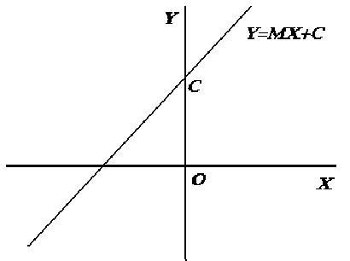
Linear Regression
When the relationship between independent variable and dependent variable is linear.
Y = a + bX
Estimated value Y_{i} = a + bX_{i} + e_{i}
Notes:
In London

Slide 9
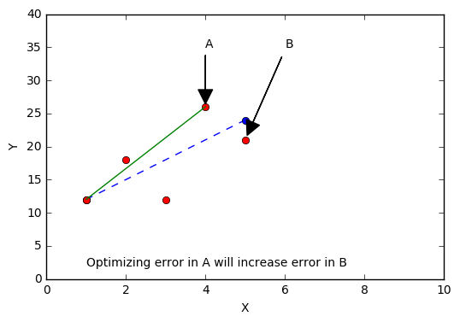
Linear Regression
If we optimize observed errors individually then other errors would increase in magnitude.
Notes:
In London

Slide 10
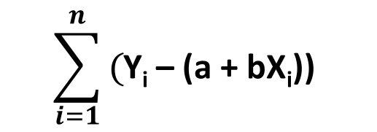
Linear Regression
Thus, we should try to make sum of all errors as close as possible to zero. This will minimize overall error and make over all predictions better.
So, this sum should be minimized, right?
$$\sum_{i=1}^{n}{\text{(}\text{Y}\text{i}\text{ – (}\text{a}\text{ + }\text{bXi}\text{)) }}$$
Notes:
In London

Slide 11
Linear Regression
Sum can be made zero by many choices of totally unsuitable lines. Negative and positive values will cancel out. Sum of large variations can also become zero.
7
4
-4
-7
Notes:
In London

Slide 12
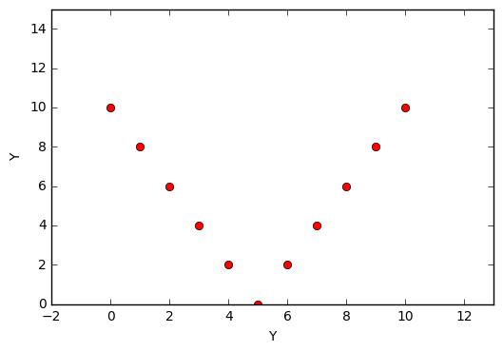
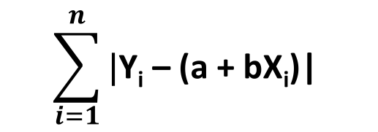

Linear Regression
We can use absolute sum of errors.
$$\text{|}\text{Y}\text{i}\text{ – (}\text{a}\text{ + }\text{bXi}\text{)|}$$
$$\sum_{i=1}^{n}{\text{|}\text{Y}\text{i}\text{ – (}\text{a}\text{ + }\text{bXi}\text{)| }}$$
Notes:
In London

Slide 13
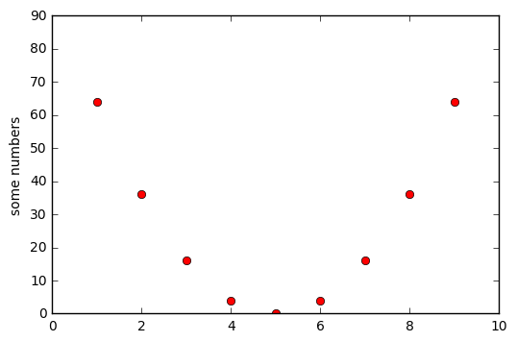
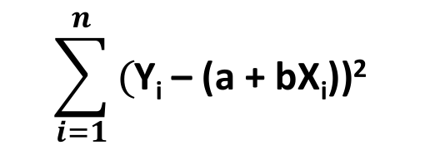

Linear Regression
We can use squared sum of errors.
$$e\text{ = }\text{(}\text{Y}\text{i}\text{ – (}\text{a}\text{ + }\text{bXi}\text{))}\text{2}$$
$$\sum_{i=1}^{n}{\text{(}\text{Y}\text{i}\text{ – (}\text{a}\text{ + }\text{bXi}\text{))}\text{2} }$$
Notes:
In London

Slide 14
Linear Regression
These minimization functions are also known as cost functions.
We have already seen two of the cost functions, there could be many cost functions. In practice, Squared sum of errors or least square sum is the one which is being used the most.
Squared errors give us a more uniformly distributed graph. With nice mathematical properties. It is convenient to work with. Uniformly differentiable.
That said, there are different school of thoughts regarding absolute sum and square sum.
Notes:
In London

Slide 15
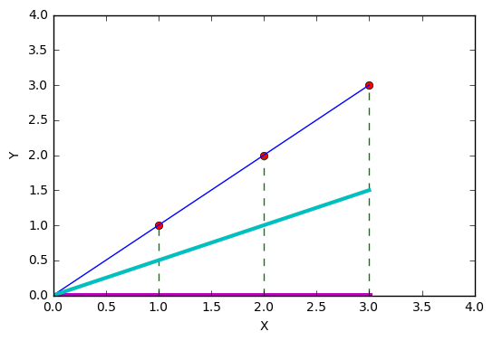
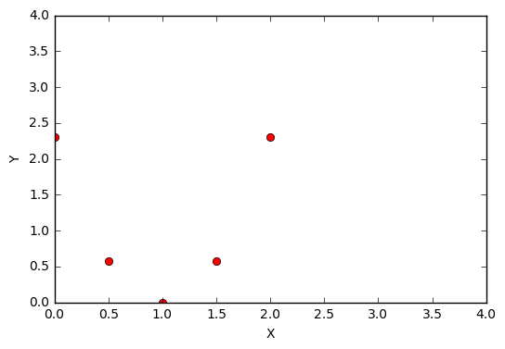
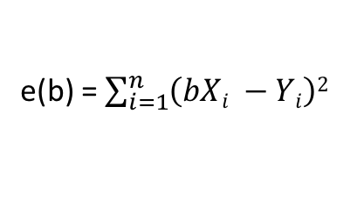
Linear Regression
e(b) = $\sum_{i=1}^{n}{\left(bXi −Yi\right)2}$
Y(X) = bX
*Divided by 2n
As expected, we have best fit one e(b) is minimum i.e. 0 at b = 1 and line of regression has minimum error.
Notes:
In London

Slide 16
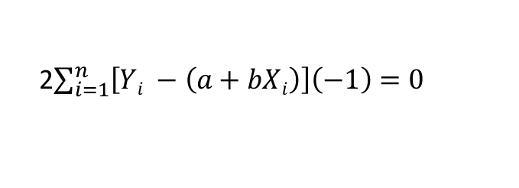
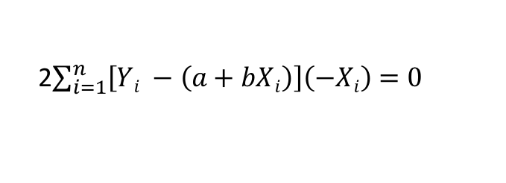
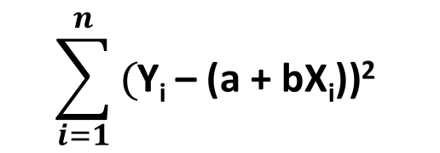


Linear Regression
Thus, a necessary condition for relative minimum is vanishing of the partial derivatives with respect to a and b. We thus have:
$$\frac{∂f}{∂a}$$
$$\sum_{i=1}^{n}{\text{(}\text{Y}\text{i}\text{ – (}\text{a}\text{ + }\text{bXi}\text{))}\text{2} }$$
2$\sum_{i=1}^{n}{\left[Yi −\left(a+bXi\right)\right]\left(−1\right)=0}$
$$\frac{∂f}{∂b}$$
2$\sum_{i=1}^{n}{\left[Yi −\left(a+bXi\right)\right]\left(−Xi\right)=0}$
Notes:
In London

Slide 17

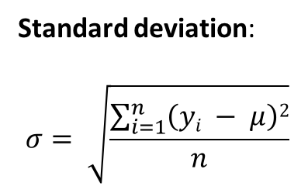
Linear Regression
Variance :
Variation of values of dependent variable from mean.
$\frac{\sum_{i=1}^{n}{\left(yi −μ\right)2}}{n}$
Standard deviation:
$$σ= \sqrt{\frac{\sum_{i=1}^{n}{\left(yi − μ\right)2}}{n}}$$
Notes:
In London

Slide 18
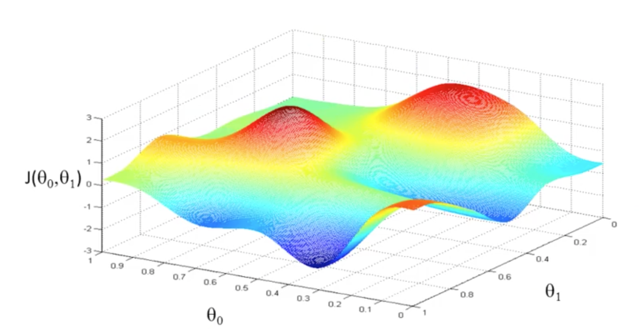
Linear Regression – Gradient Descent
Notes:
In London

Slide 19
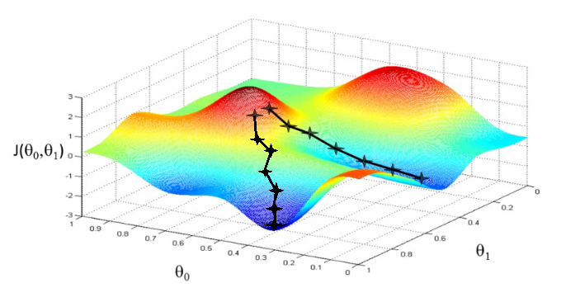
Linear Regression – Gradient Descent
Notes:
In London

Slide 20
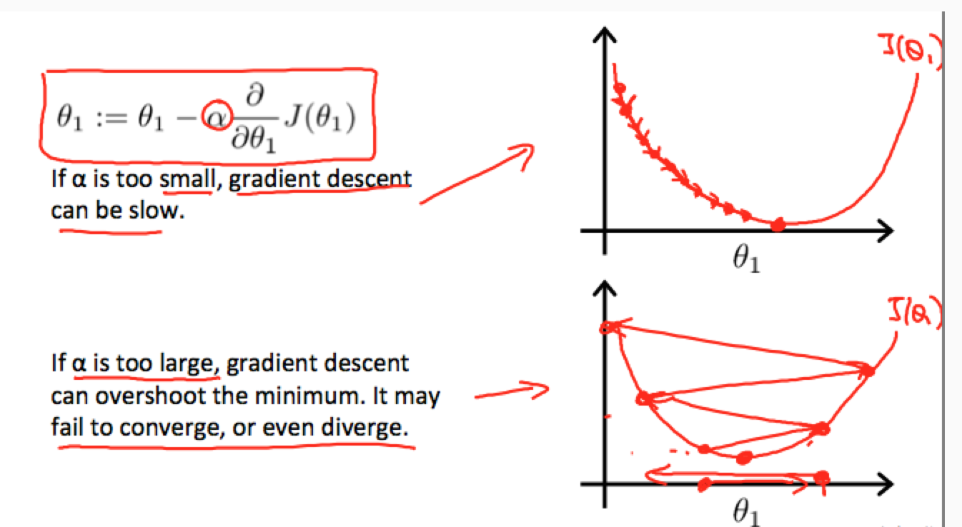
Linear Regression – Gradient Descent
Notes:
In London

Slide 21
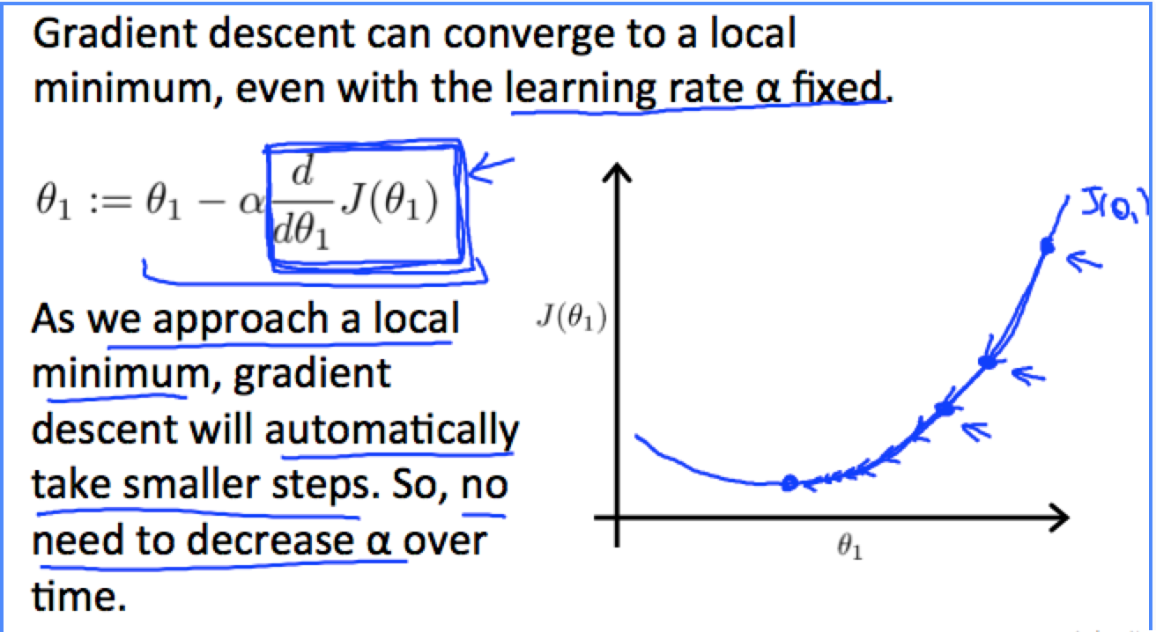
Linear Regression – Gradient Descent
Notes:
In London

Slide 22
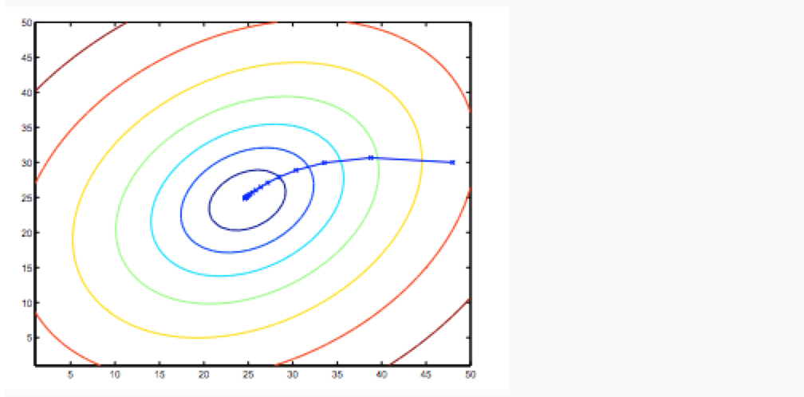
Linear Regression – Gradient Descent
Notes:
In London

Slide 23
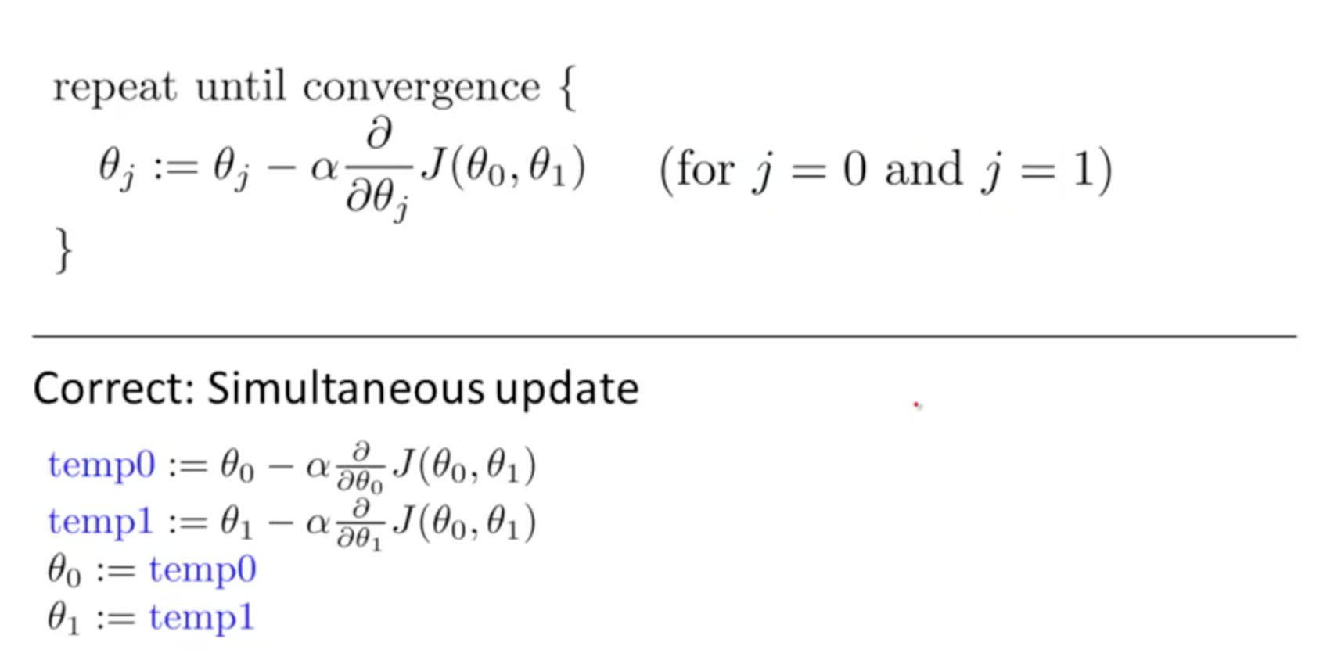
Linear Regression – Gradient Descent
http://www.onmyphd.com/?p=gradient.descent
Notes:
http://www.onmyphd.com/?p=gradient.descent

Slide 24
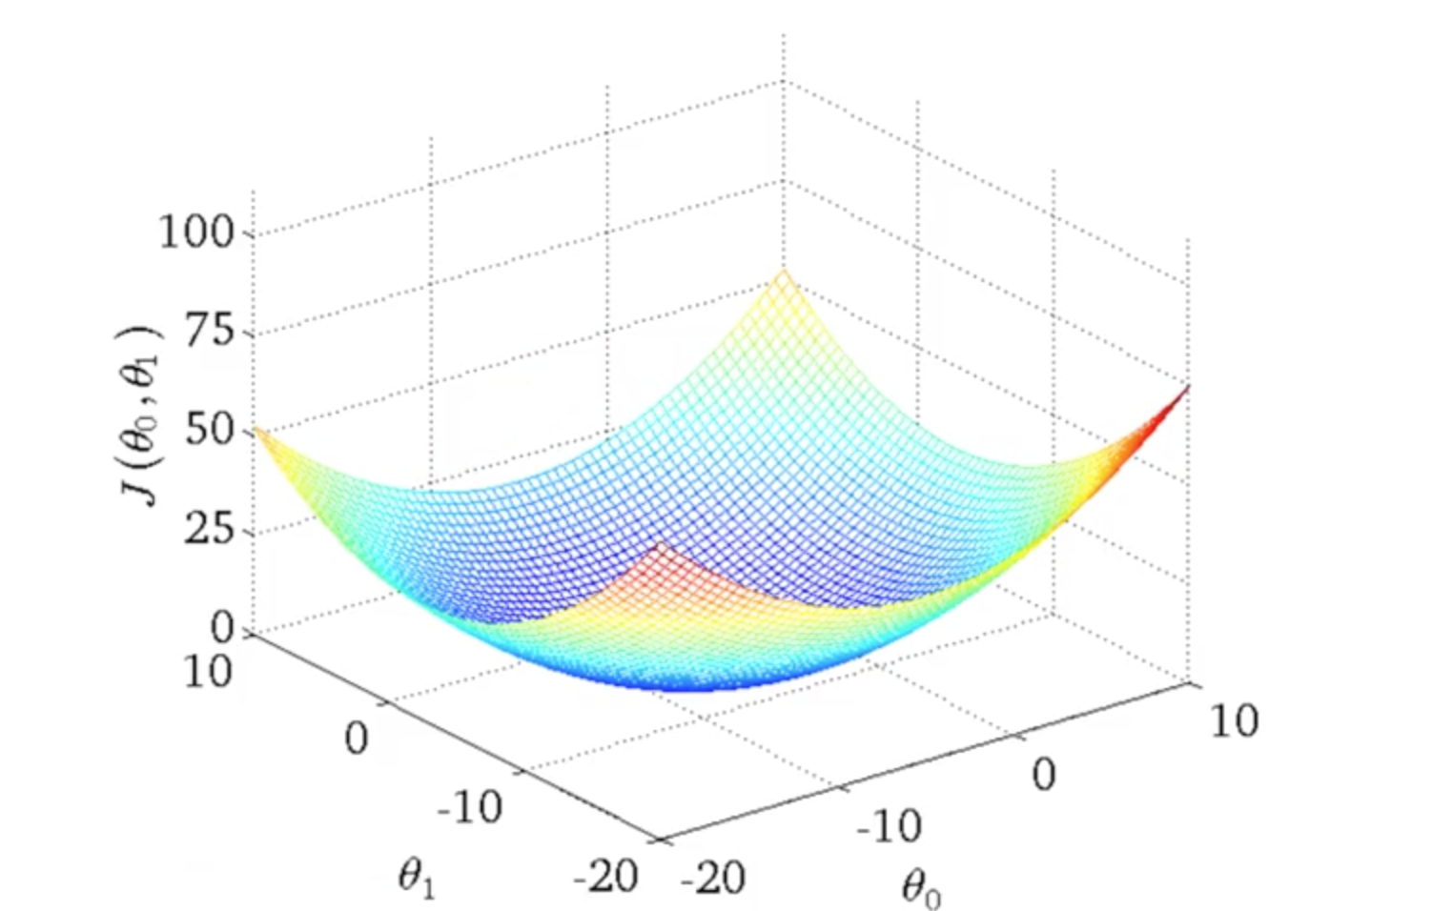
Linear Regression
Notes:
In London

Slide 25
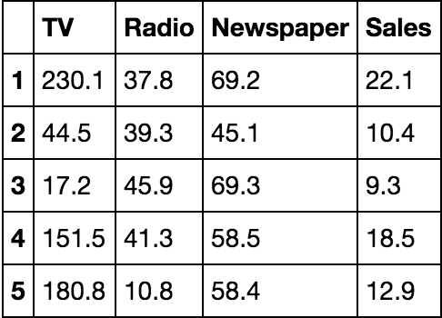
Example
We will study relationship between sales and market spend on TV, Radio and News Paper advertisements.
Load data with Pandas
import pandas as pd data = pd.read_csv('http://www-bcf.usc.edu/~gareth/ISL/Advertising.csv', index_col=0)
Visualize our data:
data.head()
Notes:
In London

Slide 26
Example
Knowing our data:
What are the features?
TV: advertising dollars spent on TV for a single product in a given market (in thousands of dollars)
Radio: advertising dollars spent on Radio
Newspaper: advertising dollars spent on Newspaper
What is the response?
Sales: sales of a single product in a given market (in thousands of widgets)
Size of sample:
data.shape
Notes:
In London

Slide 27
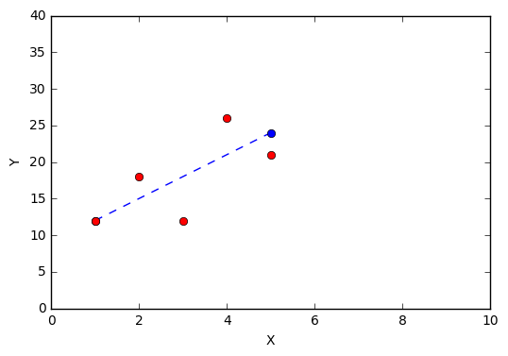
Matplotlib
import matplotlib.pyplot as plt plt.plot([1, 5], [12,24], "o--") plt.plot([1,2, 3, 4, 5], [12,18,12,26, 21], "ro") plt.ylabel('Y') plt.xlabel('X') plt.axis([0, 10, 0, 40]) plt.show()
Notes:
In London

Slide 28
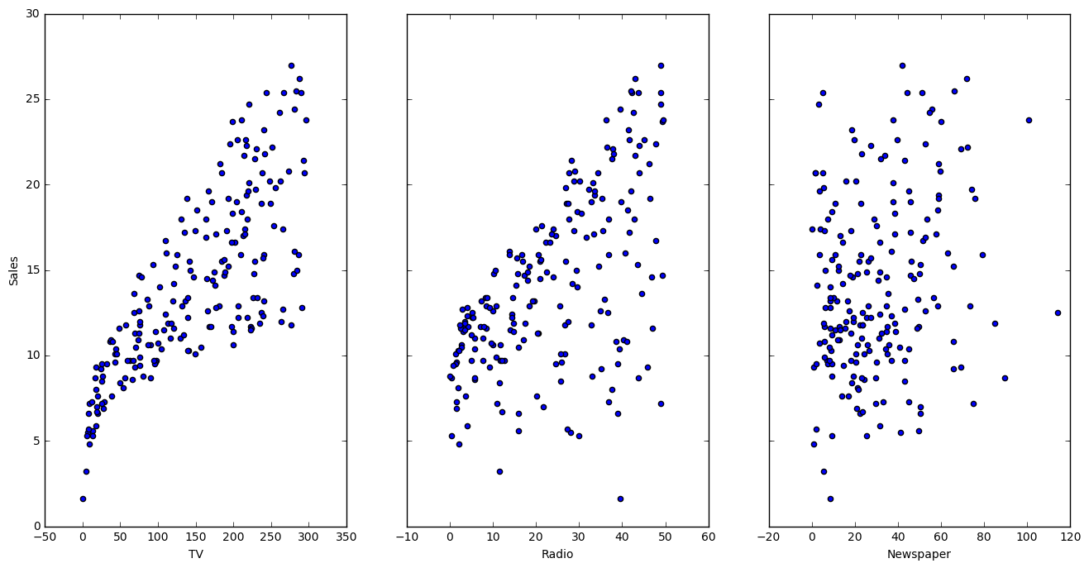
Visualize relationship
fig, axs = plt.subplots(1, 3, sharey=True) data.plot(kind='scatter', x='TV', y='Sales', ax=axs[0], figsize=(16, 8)) data.plot(kind='scatter', x='Radio', y='Sales', ax=axs[1]) data.plot(kind='scatter', x='Newspaper', y='Sales', ax=axs[2])
Notes:
In London

Slide 29
Questions about our data
Is there any relationship between ads and sales?
How strong is that relationship?
Which ad type(s) contribute to sales?
What is the effect of each ad type of sales?
Given ad spending in a particular market, can sales be predicted?
Notes:
In London

Slide 30
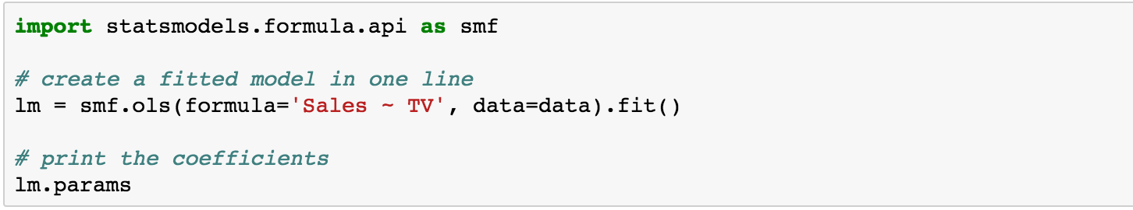
Estimate model coefficients
Notes:
In London

Slide 31
Understanding coefficients
A "unit" increase in TV ad spending is associated with a 0.047537 "unit" increase in Sales.
Or more clearly: An additional $1,000 spent on TV ads is associated with an increase in sales of 47.537 widgets.
If an increase in TV ad spending was associated with a decrease in sales, b would be negative.
Predicting values
Y = a + bx
Y = 7.032594 + 0.047537×50
Notes:
In London

Slide 32
Predicting using statsmodel
Add new dataframe
X_new = pd.DataFrame({'TV': [50]}) X_new.head()
Predicting values using model
lm.predict(X_new)
Notes:
In London

Slide 33
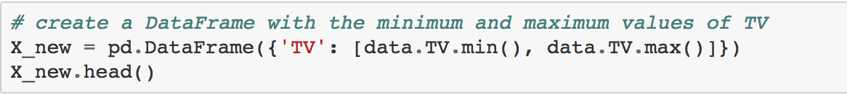
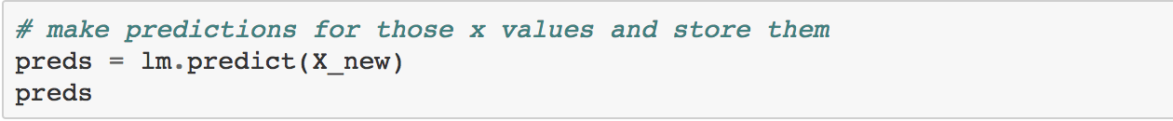
Plotting least square line
Create Dataframe
Let's make predictions for the smallest and largest observed values of x, and then use the predicted values to plot the least squares line:
Make predictions
Thus, we would predict Sales of 9,409 widgets in that market.
Notes:
In London

Slide 34
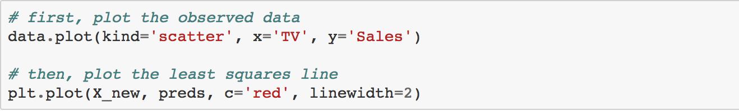
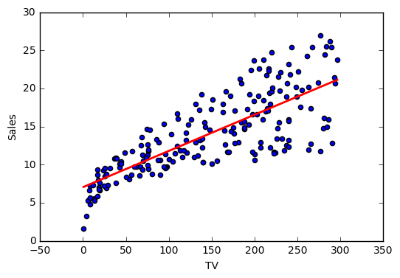
Plotting least square line
Notes:
In London

Slide 35
Linear Regression – Hypothesis
Null Hypothesis : H_{o} - No relationship or No hypothesis (factual) or Opposite of H_{a}
Alternative Hypothesis : H_{a} – Relationship we are establishing
Notes:
In London

Slide 36
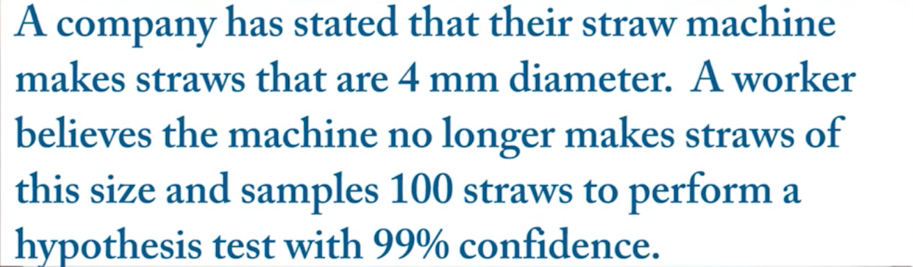
Linear Regression – Hypothesis
Notes:
Ho: u = 4 Ha: u != 4

Slide 37
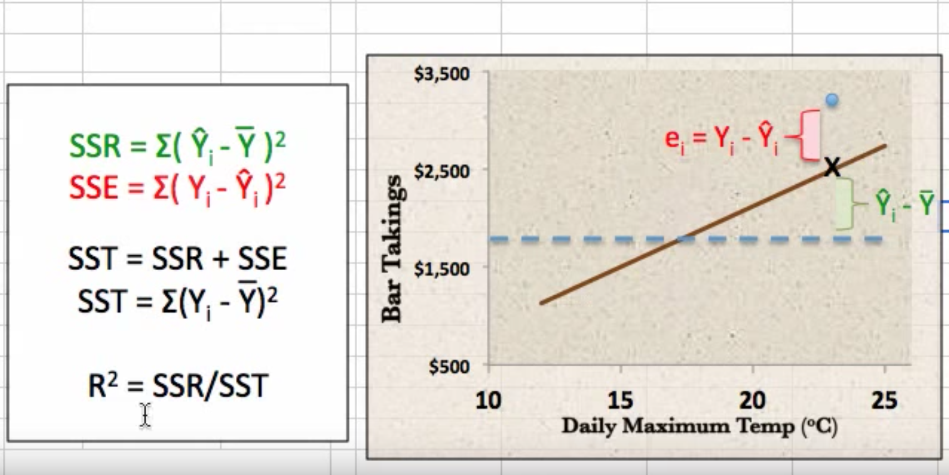
Linear Regression – R²
SSR : Sum of squares due to regression, SSE : Sum of square due to error
Notes:
In London

Slide 38
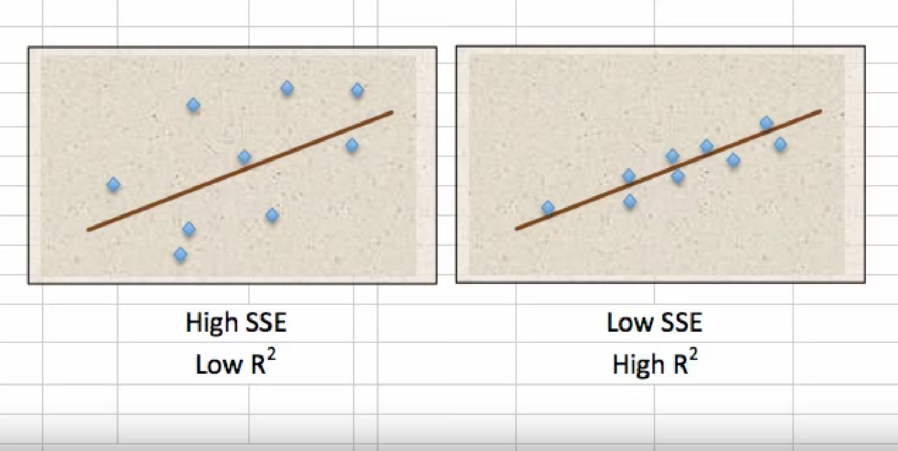
Linear Regression – R²
Notes:
In London

Slide 39
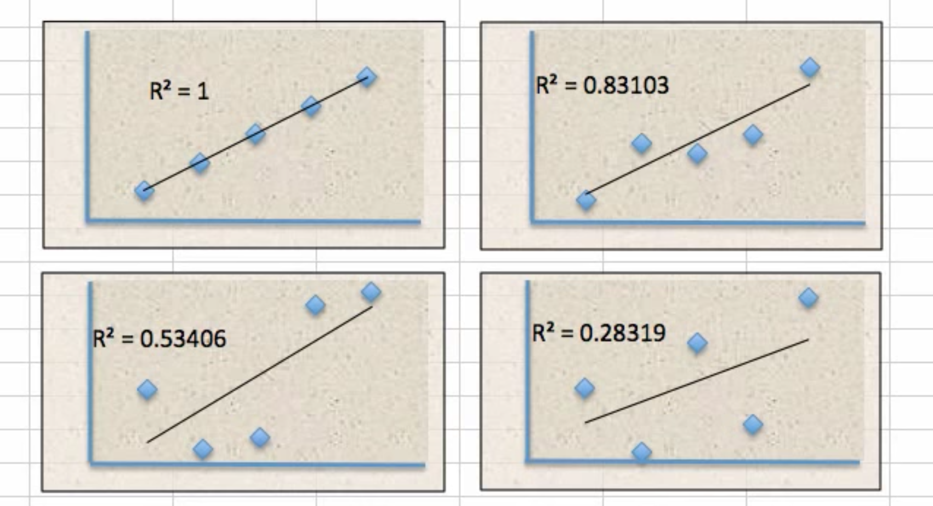
Linear Regression – R²
R2 : The proportion of the variation in Y being explained by the variation in X. Ranges between 0 to 1.
Notes:
In London

Slide 40
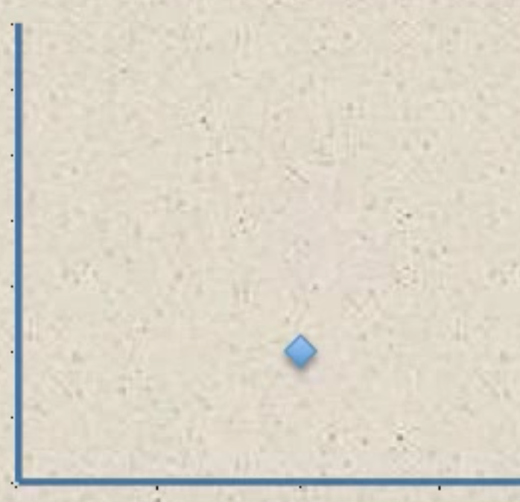
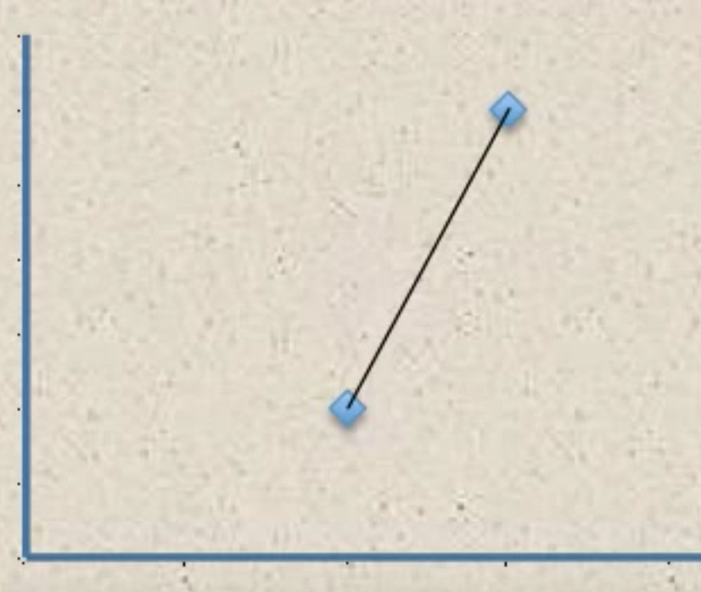
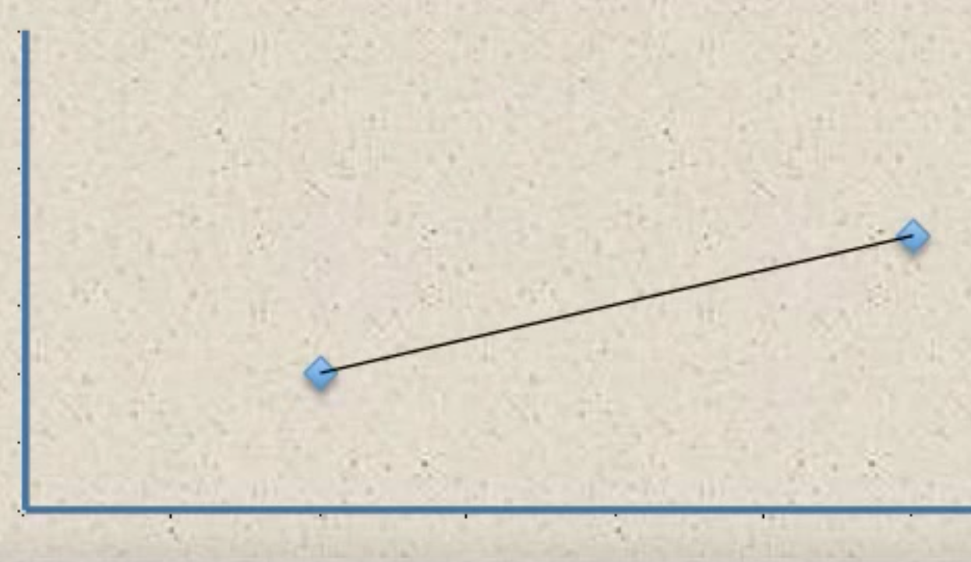
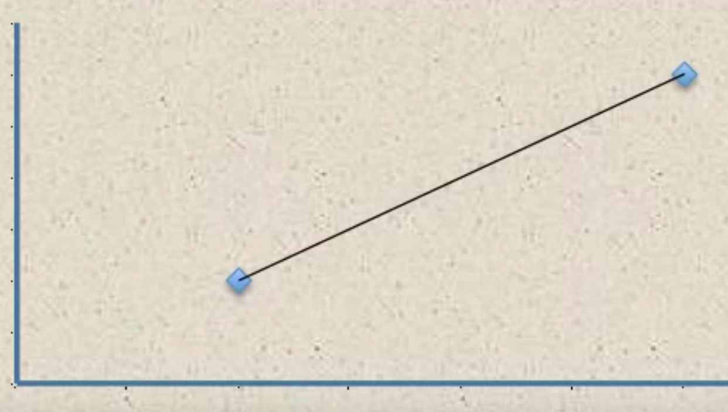
Linear Regression – Hypothesis – Degrees Of Freedom
Notes:
In London

Slide 41
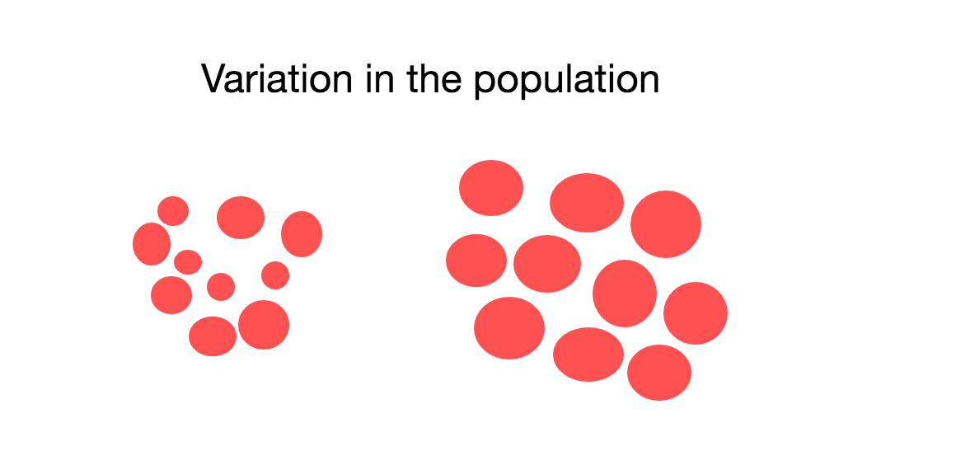
Linear Regression – Hypothesis – Probability Distribution
Notes:
In London

Slide 42
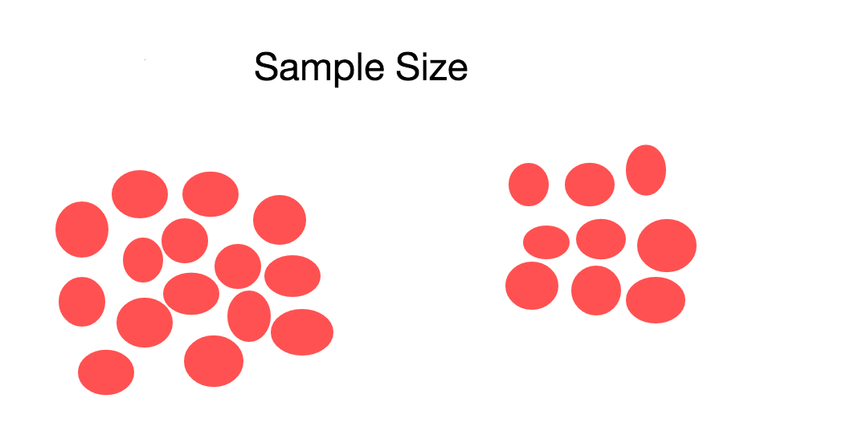
Linear Regression – Hypothesis – Probability Distribution
Notes:
In London

Slide 43
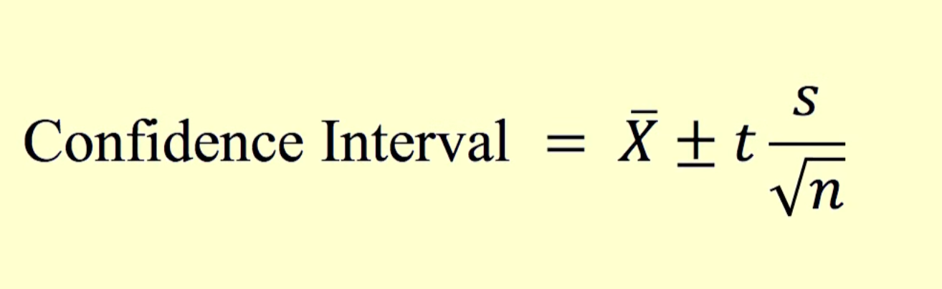
Linear Regression – Hypothesis – Probability Distribution
Notes:
In London

Slide 44
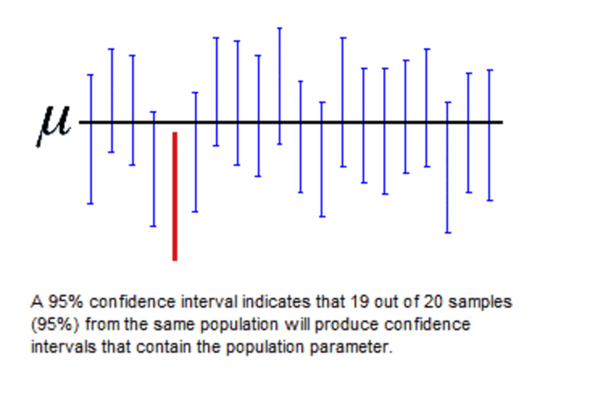
Confidence in our Model
Notes:
In London

Slide 45
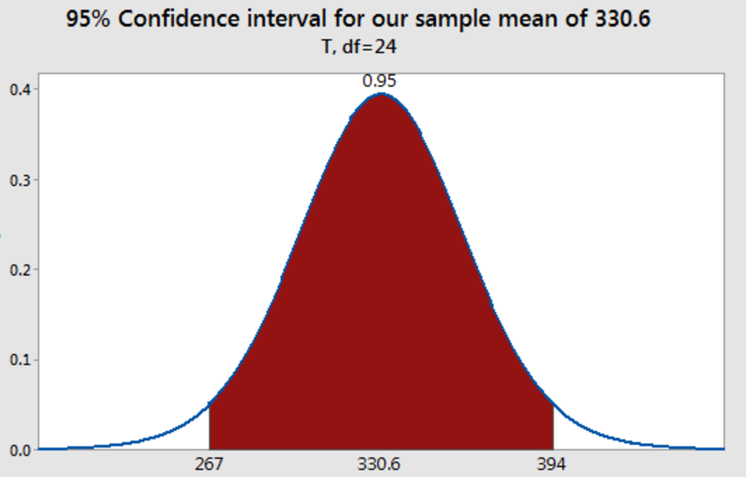
Confidence in our Model
Notes:
In London

Slide 46
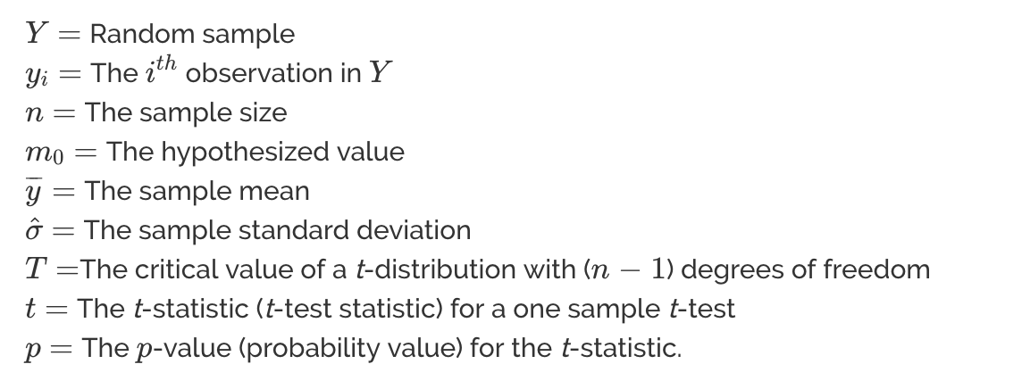
Linear Regression – Hypothesis – t-test
Notes:
In London

Slide 47
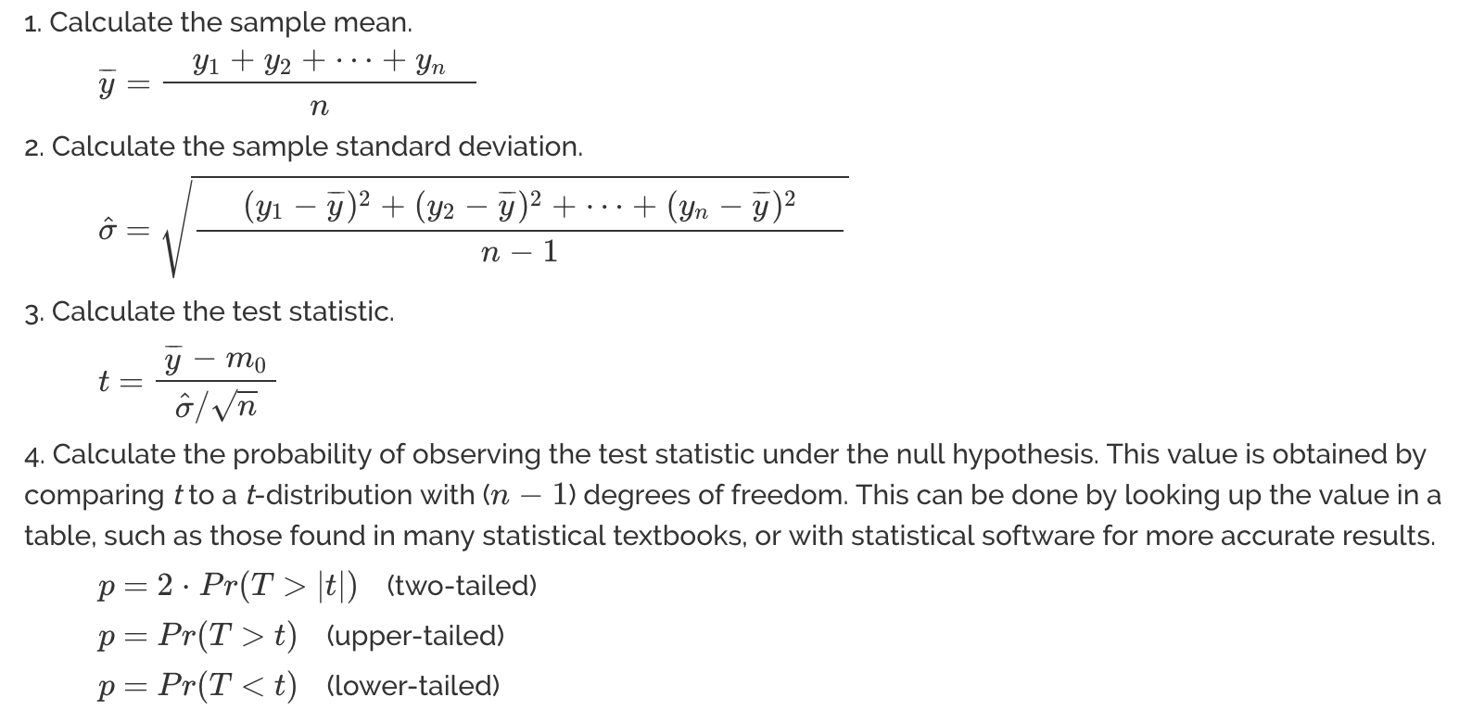
Linear Regression – Hypothesis – t-test
Notes:
In London

Slide 48
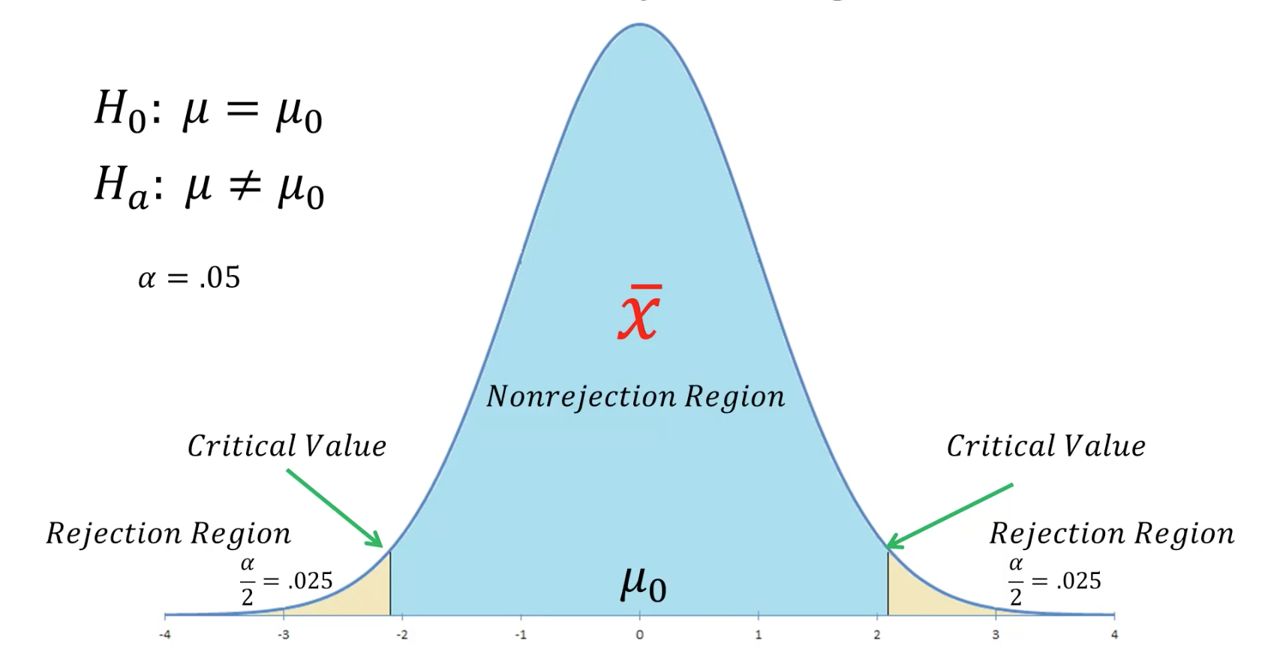
Linear Regression – Hypothesis – Probability Distribution
Notes:
In London

Slide 49

Linear Regression – Hypothesis – P value
Notes:
In London

Slide 50


Linear Regression
Notes:
In London

Slide 51



Linear Regression
Notes:
In London

Slide 52



Multi-Variable Linear Regression
Notes:
In London

Slide 53
Multi-Variable Linear Regression
What are a few key things we learn from this output?
TV and Radio have significant p-values, whereas Newspaper does not. Thus we reject the null hypothesis for TV and Radio (that there is no association between those features and Sales), and fail to reject the null hypothesis for Newspaper.
TV and Radio ad spending are both positively associated with Sales, whereas Newspaper ad spending is slightly negatively associated with Sales. (However, this is irrelevant since we have failed to reject the null hypothesis for Newspaper.)
This model has a higher R-squared (0.897) than the previous model, which means that this model provides a better fit to the data than a model that only includes TV.
Notes:
In London

Slide 54

Linear Regression – Hypothesis
Notes:
Ho: u <= 10 Ha: u > 10

Slide 55

Linear Regression – Hypothesis
Notes:
Ho: u <= 10 Ha: u > 10

